Slide 1
How to write an Article Journal: A Lesson from Ijtihad Journal
Sukron Ma’mun
Editor of Ijtihad Journal, Sharia Faculty of UIN Salatiga
Delivered a guest lecture on enhancing academic writing at the Postgraduate program UINSU Medan. October 7, 2025.

Slide 2


Sukron Ma’mun
A lecturer specialising in the sociology of religion at the Islamic State University (UIN) in Salatiga, Indonesia, earned his doctoral degree from the School of Social Science at Western Sydney University, Australia.
His instructional and scholarly endeavours centre on the examination of Islamic movements, the intersection of Islam with local traditions, and the broader field of Indonesian Islamic studies.
He participated in a brief but impactful course on Religious Pluralism at the University of California, Santa Barbara, USA (2012). He also got short scholarship from Indian Government in 2013. Furthermore, he served as a distinguished representative of emerging Islamic leaders in the prestigious Australia-Indonesia Muslim Exchange Program hosted in Australia (2014). In 2025, he received an invitation to serve as a lecturer for one week at Tashkent State University of Law in Uzbekistan
Scopus ID: 57216587230
Please do not hestitate to contact me at sukron.mn@uinsalatiga.ac.id
Find my publication at https://orcid.org/0000-0002-5268-0058 or https://scholar.google.com/citations?hl=en&user=OozbbnIAAAAJ&view_op=list_works&sortby=pubdate

Slide 3
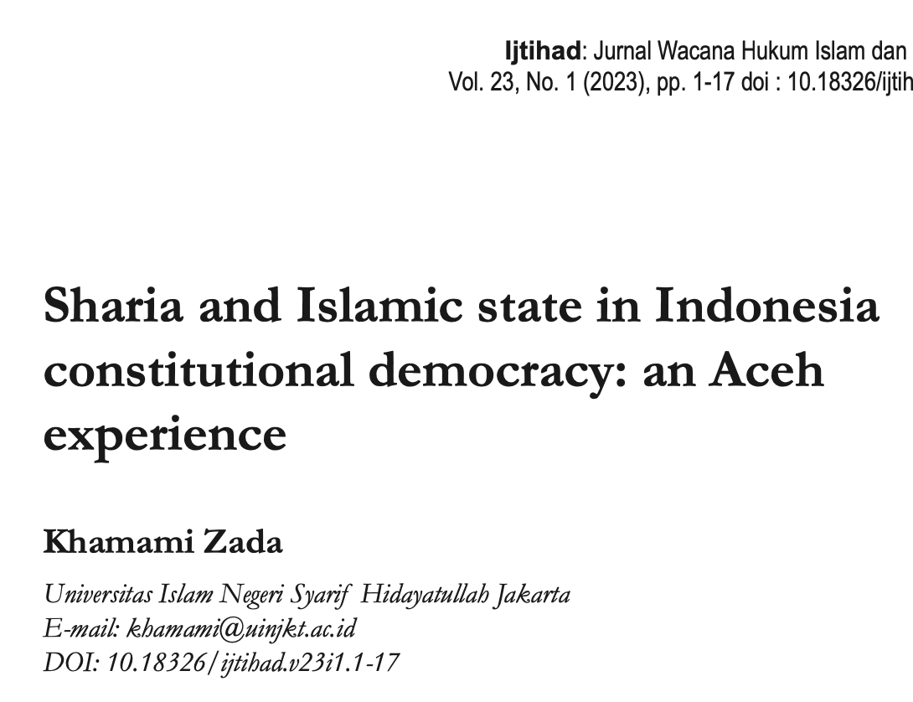

A title
Write the title in bold and use a capital in the first sentence, except words that should be written in capital, such as names, places, or abbreviation. Ideally, the title should be 10 to 15 words.

Slide 4
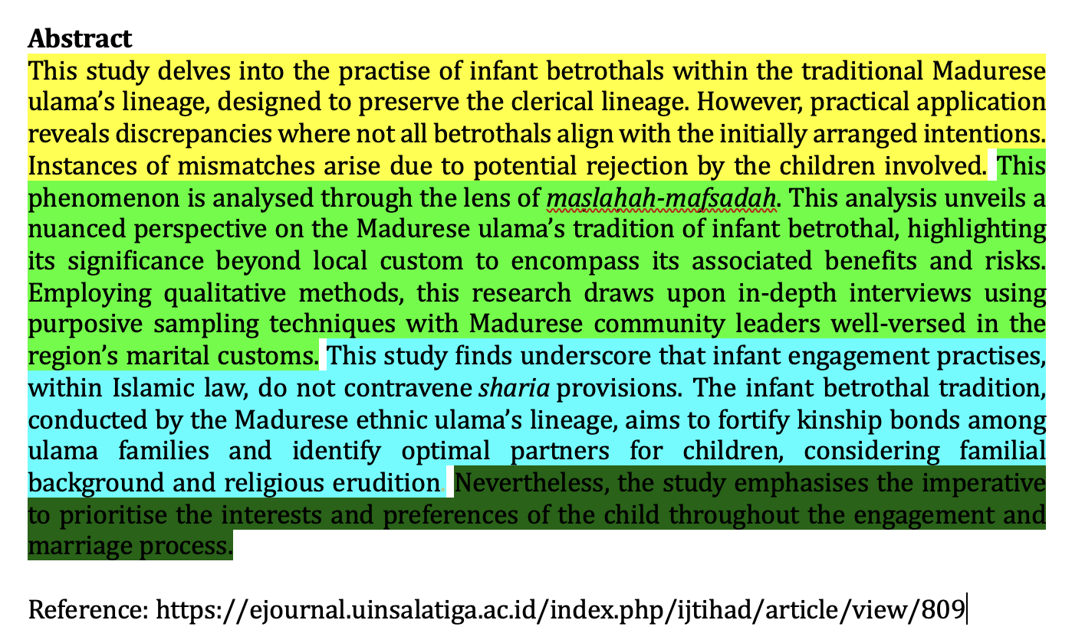
Abstract
The abstract should be clear, concise, and descriptive.
It should provide a brief introduction to the problem, objective of paper, followed by a statement regarding the method and a summary of results.
It should end with a comment on the significance of the results or a brief conclusion, and novelty of the article.
It is written in 12 pt Times New Roman, preferably between 200-250 words, and 1 line spacing.
175 words

Slide 5

Introduction
Why you believe that your research question is such an important to answer
How other scholars have or have not answered
How you think your answer would be a contribution to the existing scholarship on the subject
In the last part of your introduction, please clearly state your research questions or objectives of your articles

Slide 6
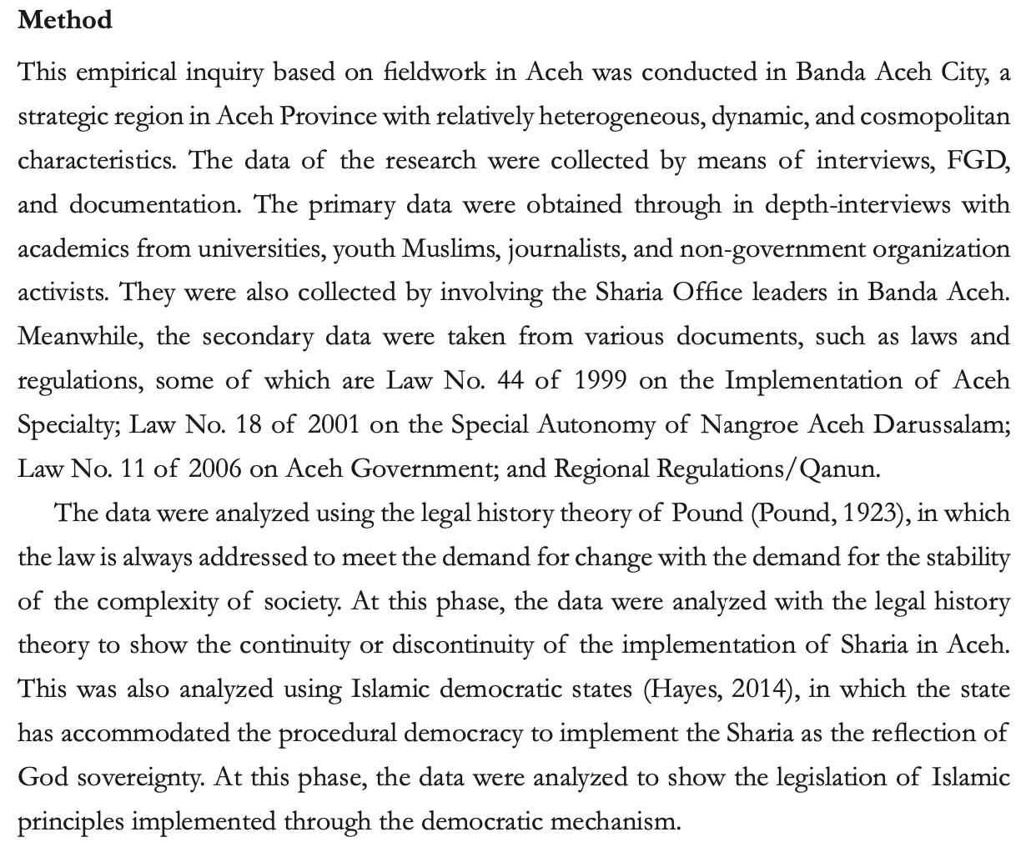
Method
A detailed description of your method in doing the research is necessary to write down in this section.
Please describe how you conduct data, theoretical framework that you apply, and how you analyse the data.
A little bit of exploration on the flows of your discussion and the expected results will be good points for closing this section. Please write briefly and efficiently.
https://ijtihad.iainsalatiga.ac.id/index.php/ijtihad/article/view/8813/pdf

Slide 7


Discussion
How do your results relate to the original question or objectives outlined in the Introduction section (what)?
Do you provide interpretation scientifically for each of your results or findings presented (why)?
Are your results consistent with what other investigators have reported (what else)? Or are there any differences?

Slide 8

Conclusion
It should answer the objectives of research. Tells how your work advances the field from the present state of knowledge. Please do not repeat the abstract or just list experimental results.
Provide a clear scientific justification for your work and indicate possible applications and extensions.
If applicable, you could recommend new areas for future research.
Write the conclusion in narration, not bullet and numeral

Slide 9
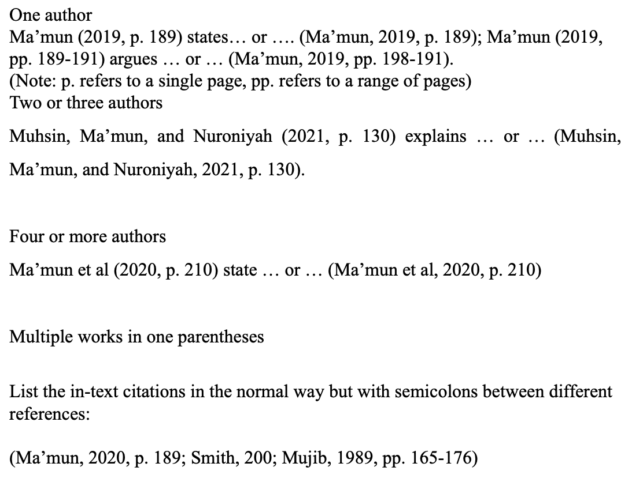
Citation
It uses Harvard style (in text-citation).
For primary citation write the family name’s author, followed by year and specific page number (if needed).
Please utilise Zotero, Mendeley or Endnote for citation and reference management.

Slide 10
Thank you

